Slide 1

The Dihybrid Cross
(page 150 & 157, 158 & 163, 164)
Comparing the inheritance of two traits in one cross, e.g. crossing round, yellow seeded pea plants with wrinkled, green seeded plants

Slide 2
RrYy x RrYy
R = round, r = wrinkled
Y = yellow, y = green
Work out possible combinations of gamete alleles
R r Y y
R
Y
R
y
r
Y
r
y

Slide 3





RrYy x RrYy
RY
Ry
rY
ry
RY
RRYY
RRYy
RrYY
RrYy
Ry
RRYy
RRyy
RrYy
Rryy
rY
RrYY
RrYy
rrYY
rrYy
ry
RrYy
Rryy
rrYy
rryy

Slide 4
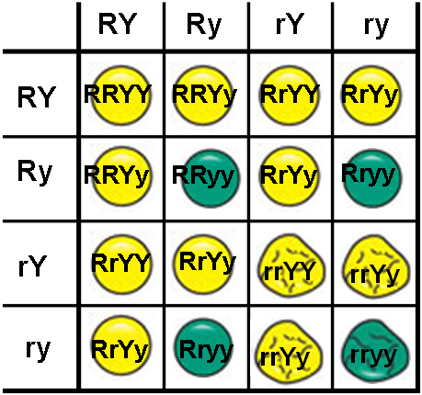




Genotypes and Phenotypes
Genotypes | Phenotypes
RRYY
1
Round/yellow
RRYy
2
Round/yellow
RrYY
2
Round/yellow
RrYy
4
Round/yellow
RRyy
1
Round/green
Rryy
2
Round/green
rrYY
1
Wrinkled/yellow
rrYy
2
Wrinkled/yellow
rryy
1
Wrinkled/green

Slide 5
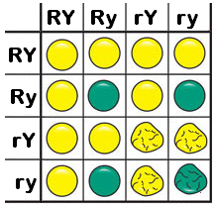



Phenotype Ratio
Round/yellow
Round/green
Wrinkled/yellow
Wrinkled/green
R– Y–
9
1
2
3
4
R– yy
3
5
1
6
2
rr Y–
3
7
8
1
2
9
3
3
1
rr yy
1
This is the 9 : 3 : 3 : 1 Ratio, typical for all dihybrid crosses between two heterozygotes.

Slide 6
Dihybrid back or test cross
This is done to check if an individual with the dominant traits is homo- or heterozygous.
Back-cross with an individual that is
homozygous recessive for both genes.
E.g. RrYy x rryy

Slide 7





The back/test-cross
Rr Yy
RY
Ry
rY
ry
rr yy
ry
RrYy
Rryy
rrYy
rryy
Phenotypes
Ratio
1 :
1 :
1 :
1

Slide 8
If the round, yellow-seeded plant were homozygous for both genes, none of the offspring would show the recessive traits.
RRYY x rryy → RrYy
(NOTE: Backcrosses can be used to show if genes are linked on the same chromosome – we’ll study this later)
END

